Slide 1
Graphing Motion

Slide 2
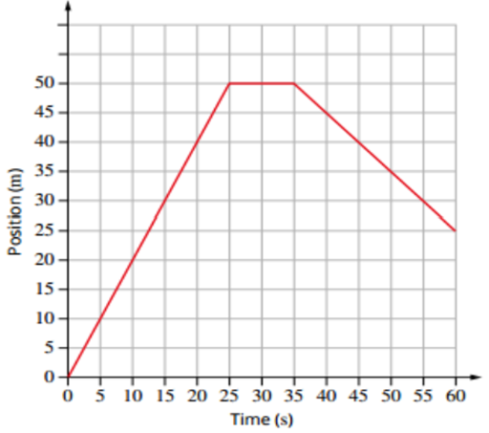
Position-Time Graphs
Also known as x-t graphs, position-time graphs indicate the position (x) of an object in one dimension over time (t).
Displacement-time (s-t) graphs are very similar but are not necessarily limited to one dimension.
This position-time graph represents the motion of a swimmer travelling 50 m along a pool, then resting and swimming back towards the starting position. The swimmer finishes halfway along the pool.

Slide 3
Position-Time Graphs
The gradient of a position-time graph can be used to determine an object’s velocity:
$$\text{gradient}=\frac{\text{rise}}{\text{run}}=\frac{Δx}{Δt}=v$$
A positive gradient indicates that the object is moving in the positive direction.
A negative gradient indicates motion in the negative direction.
A gradient of zero means the object is stationary.

Slide 4
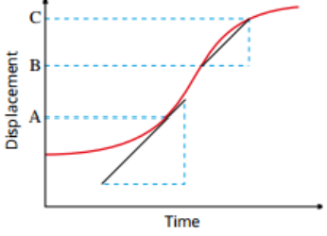
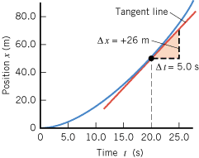
Non-Uniform Motion: Position-Time Graphs
If the velocity of an object is non-uniform (i.e. it is accelerating), its position-time graph will be curved.
The instantaneous velocity is equal to the gradient of the tangent to the curve at the point of interest.
The average velocity is equal to the gradient of a chord (straight line) between the two points of interest.

Slide 5
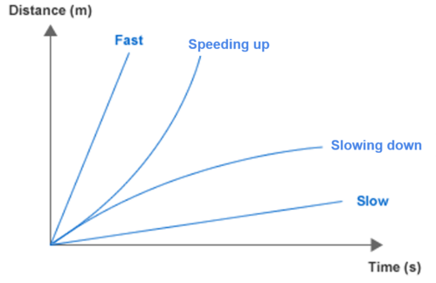
Non-Uniform Motion: Position-Time Graphs
An increasing gradient means that the object is accelerating.
A decreasing gradient means that the object is decelerating.

Slide 6
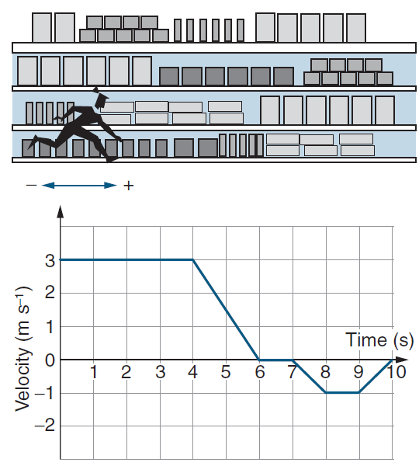
Velocity-Time Graphs
Also known as v-t graphs, velocity-time graphs indicate the velocity (v) of an object in one dimension over time (t).
The graph to the right shows the movement of a small girl up and down a supermarket aisle.
For the first 4 seconds, she runs at a constant velocity in the positive direction (i.e. to the right)
From 4 to 6 seconds she continues in the same direction but slows down. At 6 she stops for a second.
She then accelerates in the negative direction (to the left), travels at a constant velocity for a second, then slows to a stop again.

Slide 7
Velocity-Time Graphs
The gradient of a velocity-time graph can be used to determine an object’s acceleration:
$$\text{gradient}=\frac{\text{rise}}{\text{run}}=\frac{Δv}{Δt}=a$$
A positive gradient indicates that the object is accelerating in the positive direction.
A negative gradient indicates acceleration in the negative direction.
A gradient of zero means the object is moving at a constant velocity.

Slide 8
Velocity-Time Graphs
The area under a velocity-time graph can be used to determine an object’s displacement.
Any areas above the time axis represent positive displacement.
Any areas below the time axis represent negative displacement.

Slide 9
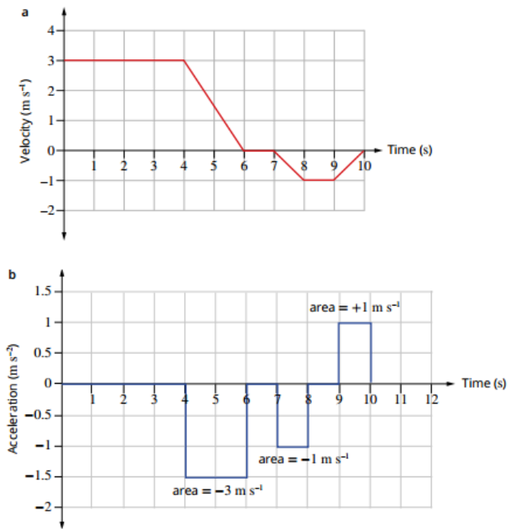
Acceleration-Time Graphs
Also known as a-t graphs, acceleration-time graphs indicate the acceleration (a) of an object in one dimension over time (t).
The area under an acceleration-time graph can be used to determine an object’s change in velocity.
Any areas above the time axis represent positive change in velocity.
Any areas below the time axis represent negative change in velocity.

